Slide 1
Better Together: Students and Faculty Working Together in Participatory Governance
Notes:
Cheryl

Slide 2
Presenters
Angelica Campos, Outgoing SSCCC President
Cheryl Aschenbach, ASCCC Vice President
LaTonya Parker, ASCCC Secretary
Notes:
All

Slide 3
Description
Students and faculty are both identified in Title 5 as having specific roles and responsibilities in participatory governance, the 9+1 and 10+1 respectively. While perspectives between faculty and students may differ, many areas of responsibility overlap. This overlap creates an opportunity to learn from each other and to advocate together to meet the needs of students. Join us to explore collaborative methods for working with each other and with other college stakeholders to provide high-quality programs and services in pursuit of shared aspirations.

Slide 4
Overview
Why work together?
Quick history of participatory governance
Student 9+1, Faculty 10+1, & Areas of Overlap
Ways students and faculty can partner in governance
Helpful practices for participating together in governance
Additional statewide opportunities and resources for you to access
Notes:
Angelica

Slide 5
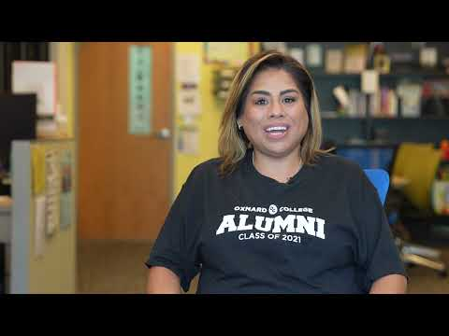
Why Work Together?
Notes:
LaTonya w/ add’l follow-up from Angelica
https://youtu.be/m2iUWW9Cit4

Slide 6
History of Participatory Governance
AB 1725 (Vasconcellos, 1988) Community College Reform Act
Separated community colleges from K-12
Established framework for participatory governance
  CA Ed Code §70902(b)(7) Establish procedures that are consistent with minimum standards established by the board of governors to ensure faculty, staff, and students the opportunity to express their opinions at the campus level, to ensure that these opinions are given every reasonable consideration, to ensure the right to participate effectively in district and college governance, and to ensure the right of academic senates to assume primary responsibility for making recommendations in the areas of curriculum and academic standards.
Title 5 Regulations further defined roles/responsibilities for students, faculty, and classified staff
Notes:
Cheryl

Slide 7
What is the Value of Participatory Governance?
Supports inclusiveness of individual and community viewpoints in collaborative decision-making processes
Develops greater sense of participation and ownership
Promotes mutual respect and trust through open communication and collaboration
Notes:
Angelica

Slide 8
Student 9+1
Grading Policies
Codes of Student Conduct
Academic disciplinary policies
Curriculum development
Courses or programs which should be initiated or discontinued
Processes for institutional planning and budget development
Standards and policies regarding student preparation and success
Student services planning and development
Student fees within the authority of the district to adopt
The + 1 in student rights is meant to account for anything else that a college or district thinks will have a significant impact on students
Notes:
Angelica

Slide 9
Faculty 10+1
Academic and Professional Matters
Curriculum, including establishing prerequisites and placing courses within disciplines
Degree and certificate requirements
Grading policies
Educational program development
Standards or policies regarding student preparation and success
District and college governance structures, as related to faculty roles
Faculty roles and involvement in accreditation processes
Policies for faculty professional development activities
Processes for program review
Processes for institutional planning and budget development
+ 1 Other academic and professional matters
Notes:
LaTonya

Slide 10
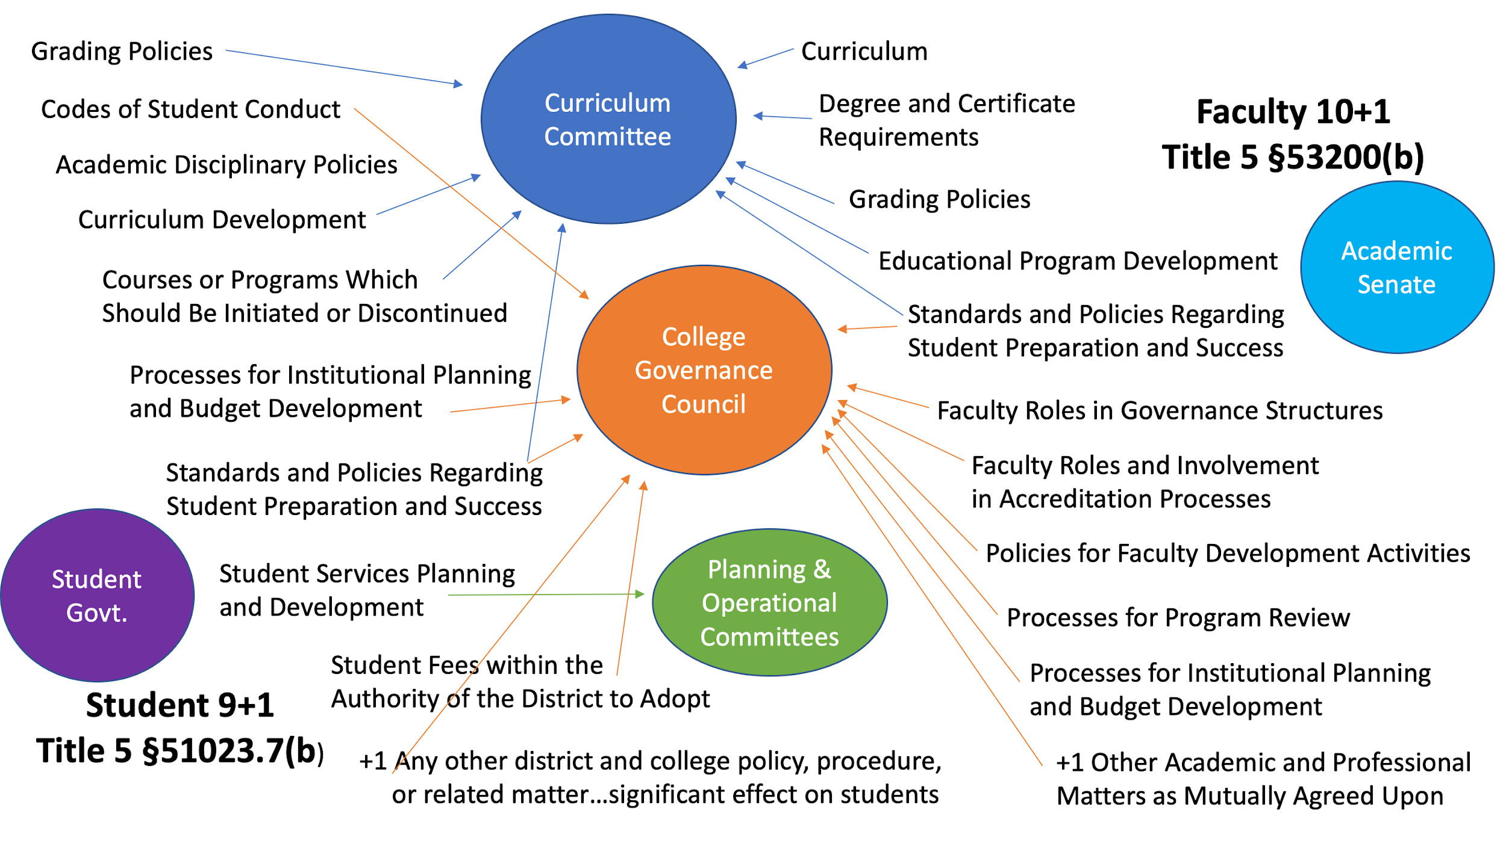
Notes:
Cheryl

Slide 11
Areas of Overlap: Examples
Grading policies, including plus/minus grading
Facilities use and planning, including bonds
Academic probation policies
Planning processes, including for student services, instruction, technology, and more
Hiring processes
Program development and discontinuation
Smoking/No Smoking policies
Campus safety and policing
Notes:
Angelica & LaTonya

Slide 12
Areas of Overlap: Student Grievance Policy
CCLC Board Policy Template AP 5530 Student Rights & Grievances
Student-led effort
Broad representation and collaboration
Increase student accessibility to process
Transition from complicated process to simpler process
Recommended actions to take:
Review current policy.
Faculty & students connect to discuss it and consider updates.
Notes:
Angelica & Cheryl

Slide 13
Ways Students & Faculty Can Partner
Identify areas of shared interest
Student Body Association and Academic Senate leadership meetings / regular dialog
  Alert each other of concerns
  Share intentions, gather information, request support or collaboration as needed
  Sounding board
  Strategize for College Council or planning meetings
Attend each other’s meetings
Shared orientation to participatory governance
  Overview of committee service opportunities
  Opportunity to identify faculty mentors
  Faculty introduced to student priorities and shared areas of interest
Notes:
Angelica & Cheryl

Slide 14
Helpful Practices for Participating in Governance
Balance many different perspectives and seek inclusive solutions
Engage others & invite them to participate in governance
The easiest way to know what matters to peers is to talk to them!
  Students:
    Student government meetings
    SBA events and activities
    Clubs and your ICC
    Classes and friends
  Faculty:
    Hallway conversations
    Department or division meetings
    Lunch room or cafeteria
  Organize town halls for larger, more important issues
Notes:
Angelica & LaTonya

Slide 15
Committee Work As An Element of Governance
Consider ways to increase and support students participation on committees
Before meetings
During meetings
After meetings
Student voice in governance is critical!
Students: Have a presence. Participate.
Faculty: Help make student presence & participation possible.
Notes:
Cheryl

Slide 16
Before Meetings:
Increasing & Supporting Student Participation
Students:
Meet with committee chair prior to first meeting and at any point later
Review past meeting agendas and minutes
Speak with constituents to gather info & opinion on committee topics
Get familiar with the committee terms
Learn about the members of that committee, consider ways to form connections
Pre-read the agenda and make sure that you are aware of which sections require student input
Faculty:
Reach out to SBA leadership to get contact info for appointed students
Work with student schedules when scheduling meetings
Consider being a mentor to students
Reach out to appointed students, arrange to meet informally
Offer background & context for committee work
Offer to review the agenda
Notes:
Angelica & Cheryl
Reason to communicate with committee chair:
Communicate with chair or committee contact if you’ll miss the meeting or be late; follow-up as needed

Slide 17
During Meetings:
Increasing & Supporting Student Participation
Students:
Bring something to take notes with!
Questions to ask yourself:
  Are there other factors this committee should be considering in their work or discussion?
  Is there a different approach I want this committee to consider?
  Is there any background knowledge I am lacking in the discussion that I need to ask about?
  Are there any assumptions the committee is making about the student perspective that is incorrect and which I need to give my input on?
  How can I address the student issues that are coming up in my committee’s work?
  Is there information or decisions I need to take back to my SBA?
Don’t forget to ask questions! Your voice and perspective are valuable!
Notes:
Angelica

Slide 18
During Meetings:
Increasing & Supporting Student Participation
Faculty:
Questions to ask yourself about student participation:
  Are there any assumptions the committee or I am making about the student perspective that is incorrect and which student input should be encouraged?
  How can I encourage student voice in committee discussions?
  How can I support the perspectives being brought up by students during the committee’s work?
  How can I help colleagues recognize the value of student voice?
Strategies to increase student participation during meetings
  Ask students to share their perspectives and ideas on issues being discussed
  Actively listen and support student ideas
Notes:
LaTonya

Slide 19
After Meetings:
Increasing & Supporting Student Participation
Report back to your SBA or academic senate
  Identify which information should be brought back to your peers
  Identify which topics require further action by SBA or academic senate
Continue to attend future meetings, remain engaged, and regularly communicate with the chair of your committee
Keep an alternate representative ready in the case you are not able to attend a committee meeting
Inform the alternate representative of anything pertinent to the committee
Follow-up with chair or a committee member if you miss a meeting
Prepare for the next meeting!
Notes:
Angelica & LaTonya

Slide 20
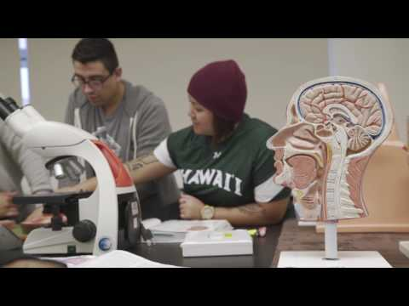
The New Majority:
Today’s College Students
Notes:
LaTonya
https://youtu.be/Xa1tfXx4oLc
The New Majority: Today's College Students

Slide 21
Stay Involved. Find Additional Resources
Students: Apply to sit on one of the SSCCC’s external committees:
https://docs.google.com/forms/d/e/1FAIpQLScRCEXejwZsb6jhR3GaAcQtRCfuLWISsuhBFpYAw5nTg4KDpw/viewform
SSCCC Participatory Resources:
https://ssccc.org/get-involved/participatory-governance.html
Faculty: Apply to serve on an ASCCC Committee:
https://asccc.org/content/new-faculty-application-statewide-service
Faculty: Local Senates Handbook:
https://asccc.org/papers/handbook2015
Notes:
Angelica & LaTonya

Slide 22



Stay Connected!
www.ssccc.org
www.asccc.org
SSCCC_Official
academic_senateccc
SSCCC_Official
ASCCCNews
Student Senate for
California Community Colleges
Academic Senate for
California Community Colleges
Notes:
Angelica & Cheryl

